Slide 1
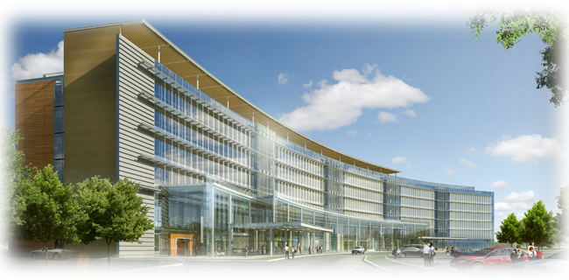

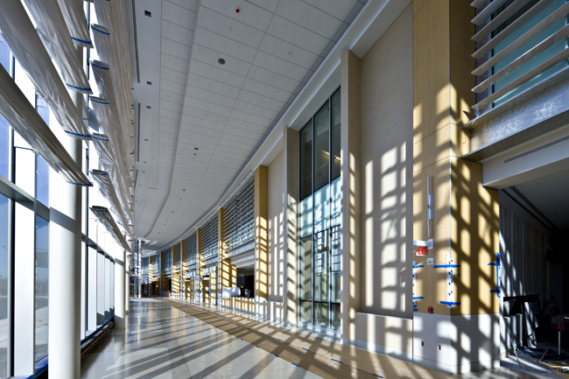


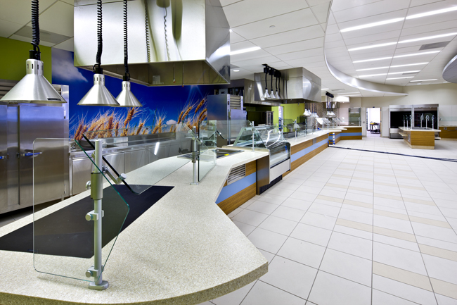
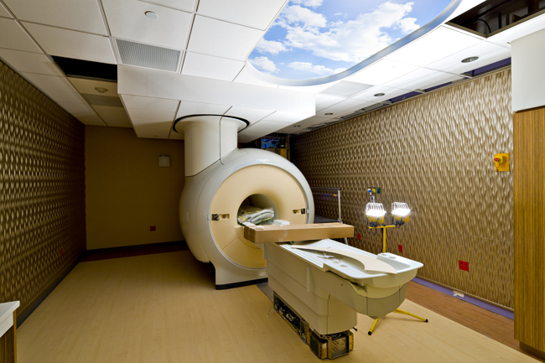
University Medical Center of Princeton
Introduction
University Medical Center of Princeton Overview
  Building
  Current systems
Goals
Depth
  Replace HRUs with GSHP/GHX
  Economic Analysis
  Implement Micro Steam Turbines
Electrical Breadth
Acoustical Breadth
Summary and Highlights
Appendices
Replacement Hospital
Timothy Berteotti
Pennsylvania State University
Architectural Engineering Department
Mechanical Option
Advisor: Dr. Treado
May 9, 2012
Princeton Health Care Systems

Slide 2
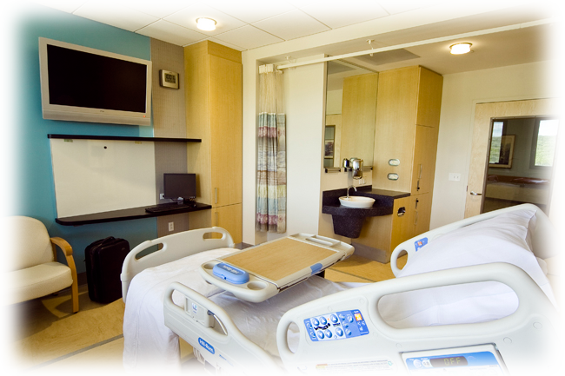
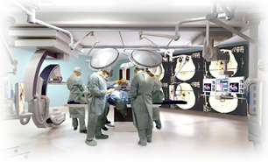
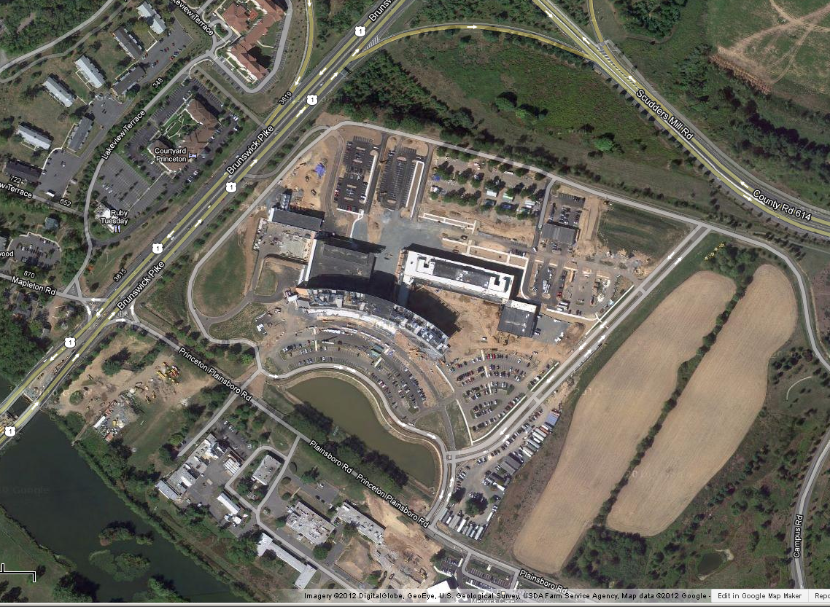

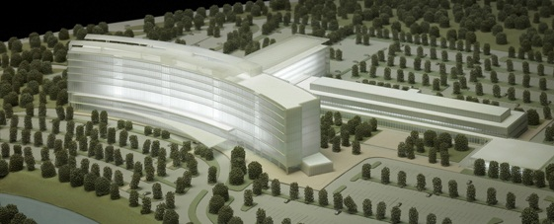
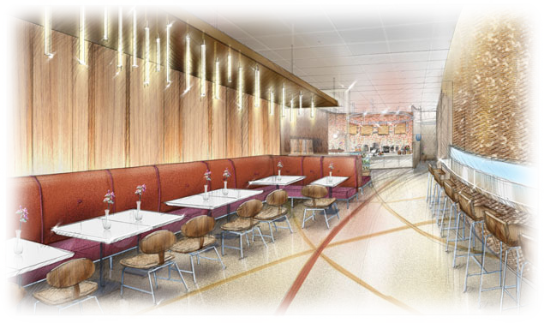
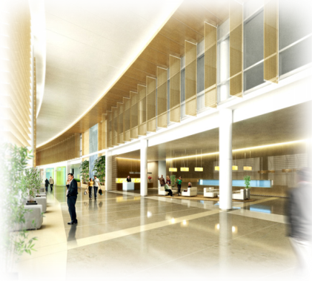
Introduction
University Medical Center of Princeton Overview
  Building
  Current systems
Goals
Depth
  Replace HRUs with GSHP/GHX
  Economic Analysis
  Implement Micro Steam Turbines
Electrical Breadth
Acoustical Breadth
Summary and Highlights
Appendices
Building Stats
Princeton Healthcare Systems
Turner Construction
Plainsboro, NJ
639,000 SF Total
$425 Million
May 2012
Patient Tower
  269 Patient Rooms
D&T
Building 2
Princeton Health Care Systems
googlemaps.com

Slide 3
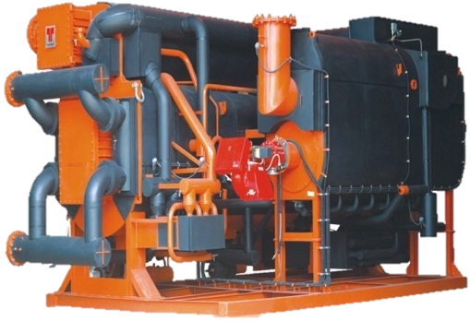
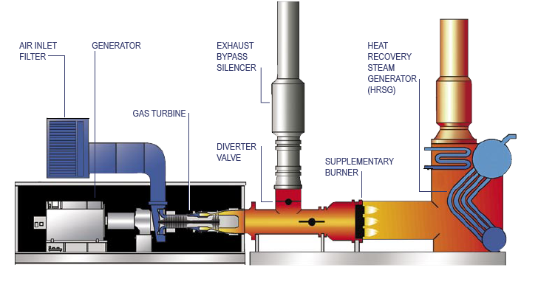
Current System
CUP
Steam
CUP
Chilled Water
150 psi Steam
Electricity
150 psi → 15 psi
Domestic HW
Heating HW
Sterilization
Introduction
University Medical Center of Princeton Overview
  Building
  Current systems
Goals
Depth
  Replace HRUs with GSHP/GHX
  Economic Analysis
  Implement Micro Steam Turbines
Electrical Breadth
Acoustical Breadth
Summary and Highlights
Appendices
Solar Mars 90 Combustion Gas Turbine
Fuel Input (MMBH) | Electrical Output (MW) | Steam Output Unfired (kpph) | Steam Output Fired (kpph) | Electrical Efficiency | Thermal Efficiency Unfired | Total Efficiency Unfired
100.4 | 9.5 | 46.8 | 113.3 | 32% | 56% | 88%
masdar.daralriyadh.com
Solar.com

Slide 4
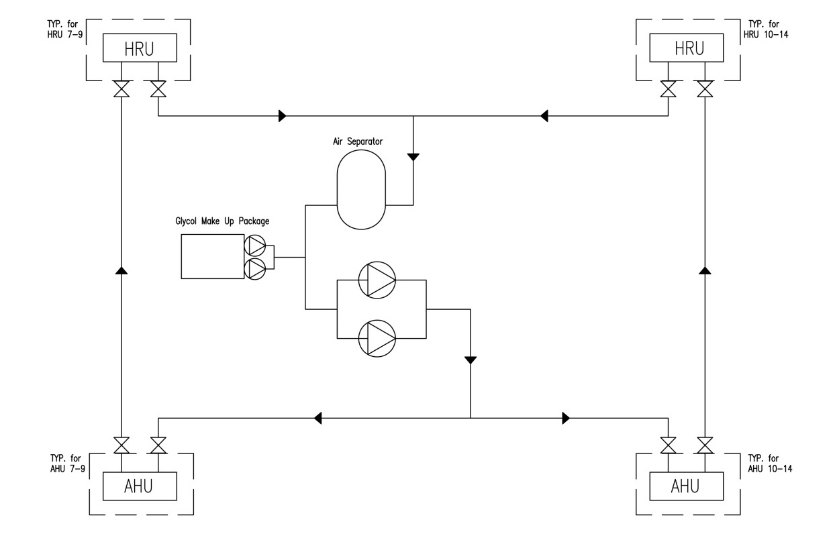
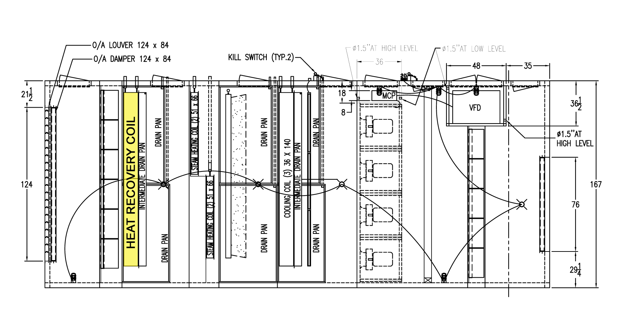
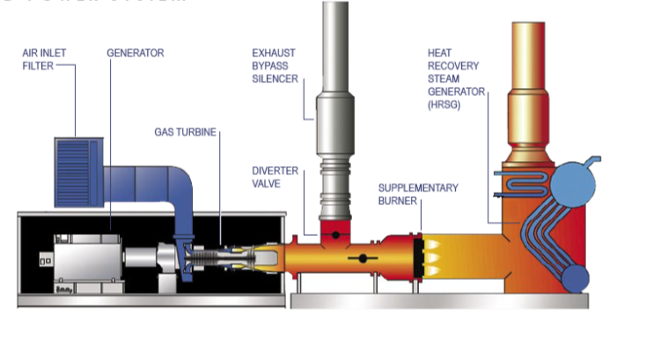

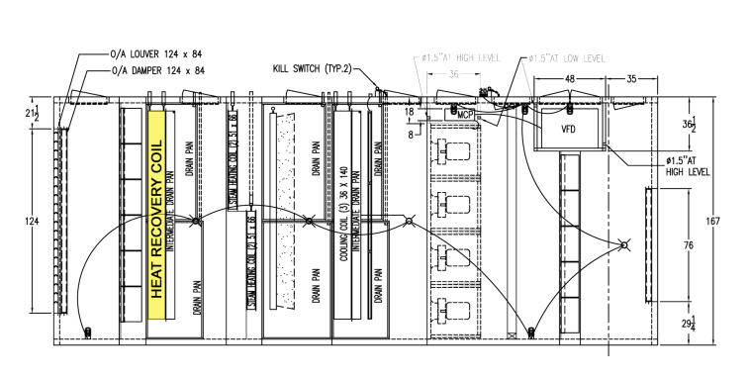
Current System
CUP
8 Roof Top AHU
CAV and VAV with Reheat
HRU
Introduction
University Medical Center of Princeton Overview
  Building
  Current systems
Goals
Depth
  Replace HRUs with GSHP/GHX
  Economic Analysis
  Implement Micro Steam Turbines
Electrical Breadth
Acoustical Breadth
Summary and Highlights
Appendices
Peak Heating and Cooling Savings from HR
Heating Base Load (MBH) | Load With HR (MBH) | Savings (MBH) |  | Cooling Base Load (Tons) | Load with HR (Tons) | Savings (Tons)
10,537 | 5,431 | 5,106 |  | 1,431 | 1,424 | 7
Simple Payback of Runaround Glycol Heat Recovery System
Heating Base Cost | Heating Cost with HR | Savings |  | Cooling Base Cost | Cooling Cost with HR | Savings |  | Total Cost Savings |  | Additional Capital Investment |  | Simple Payback (years)
$134,946 | $91,512 | $43,434 |  | $476,779 | $466,914 | $9,865 |  | $53,299 |  | $1,233,000 |  | 23

Slide 5
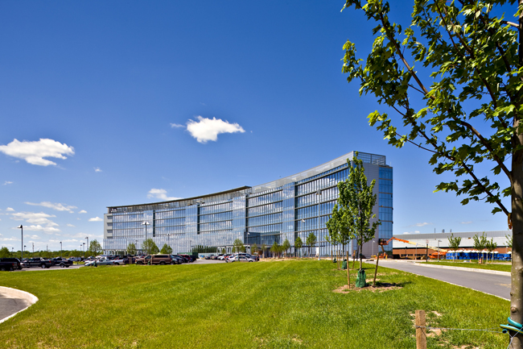
PHS Design Objectives
Project Objectives
Optimum Healing Environment
Improved Performance
Environmental Responsibility
Provide Alternative
Discover Unique Options
Compare Energy/Cost
Introduction
University Medical Center of Princeton Overview
  Building
  Current systems
Goals
Depth
  Replace HRUs with GSHP/GHX
  Economic Analysis
  Implement Micro Steam Turbines
Electrical Breadth
Acoustical Breadth
Summary and Highlights
Appendices
Electrical Breadth
Redesign of Power Distribution
Acoustical Breadth
Evaluate Current Room Acoustics
Recommend Solution
Princeton Health Care Systems

Slide 6
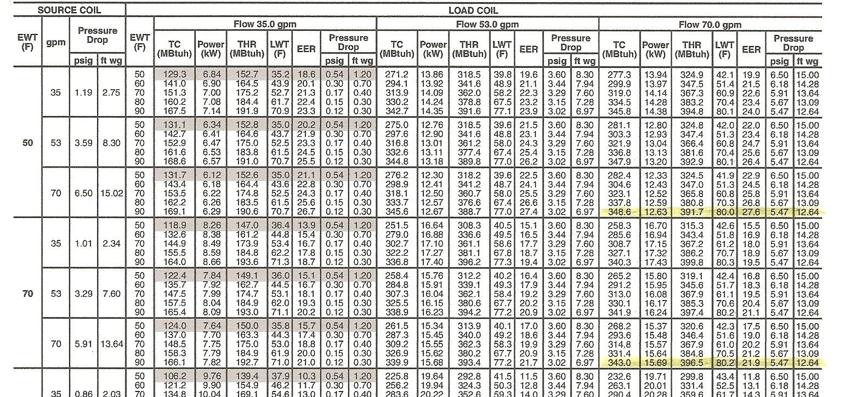
Size heat pump to match precooling load
Need one 8 Ton
Size to match water flow of 900 gpm
need 13 in parallel
Additional 367 Tons Peak Cooling Savings
Size to match preheating
Need 30 units
Peak Heating and Cooling Savings from HR
Heating Base Load (MBH) | Load With HR (MBH) | Savings (MBH) |  | Cooling Base Load (Tons) | Load with HR (Tons) | Savings (Tons)
10,537 | 5,431 | 5,106 |  | 1,431 | 1,424 | 7
Introduction
University Medical Center of Princeton Overview
  Building
  Current systems
Goals
Depth
  Replace HRUs with GSHP/GHX
  Economic Analysis
  Implement Micro Steam Turbines
Electrical Breadth
Acoustical Breadth
Summary and Highlights
Appendices
What if no HP and only GHX?
Lc = 25,637 ft / HP => 333,281 feet total
8,008 MBH Heating Capacity
Additional 2,902 MBH Peak Heating Savings

Slide 7
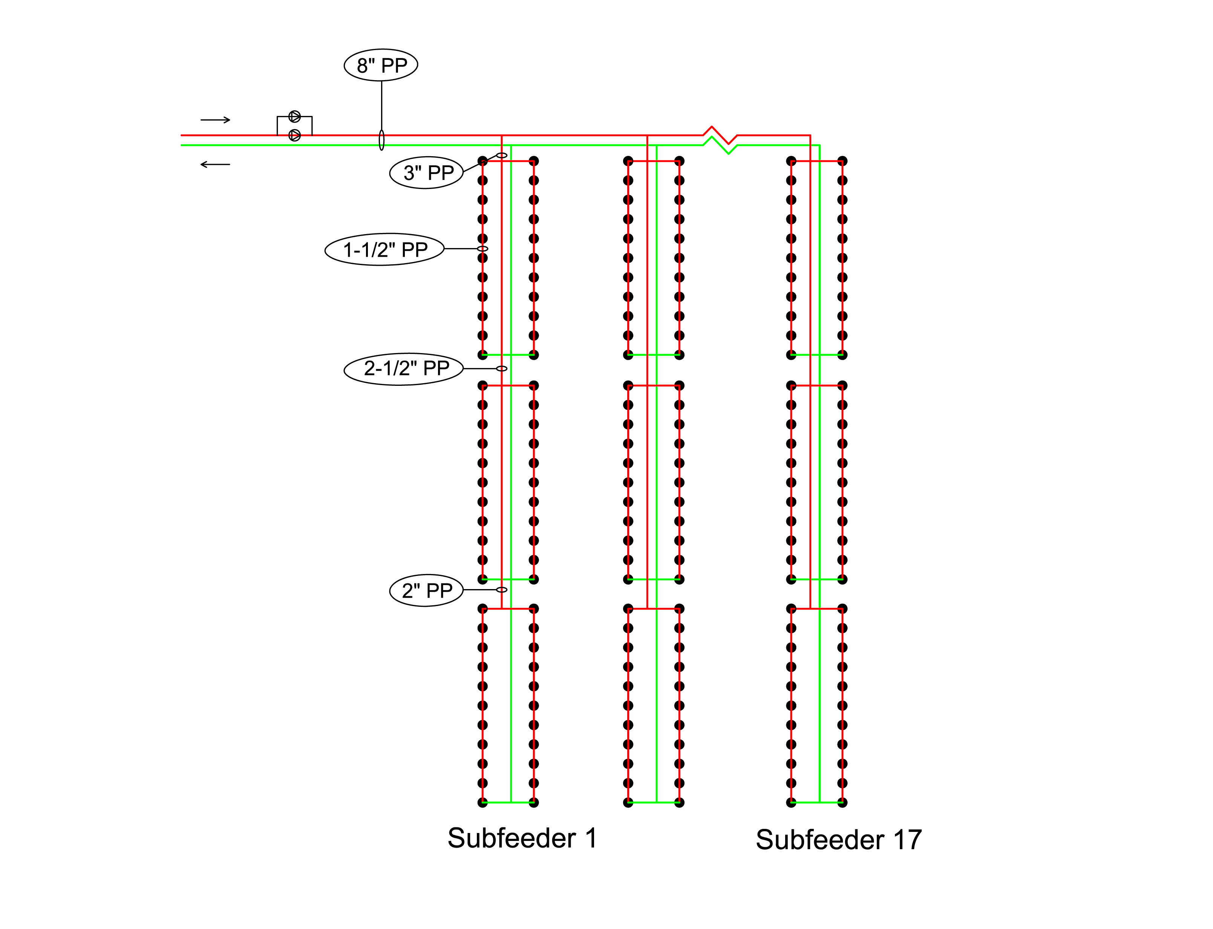
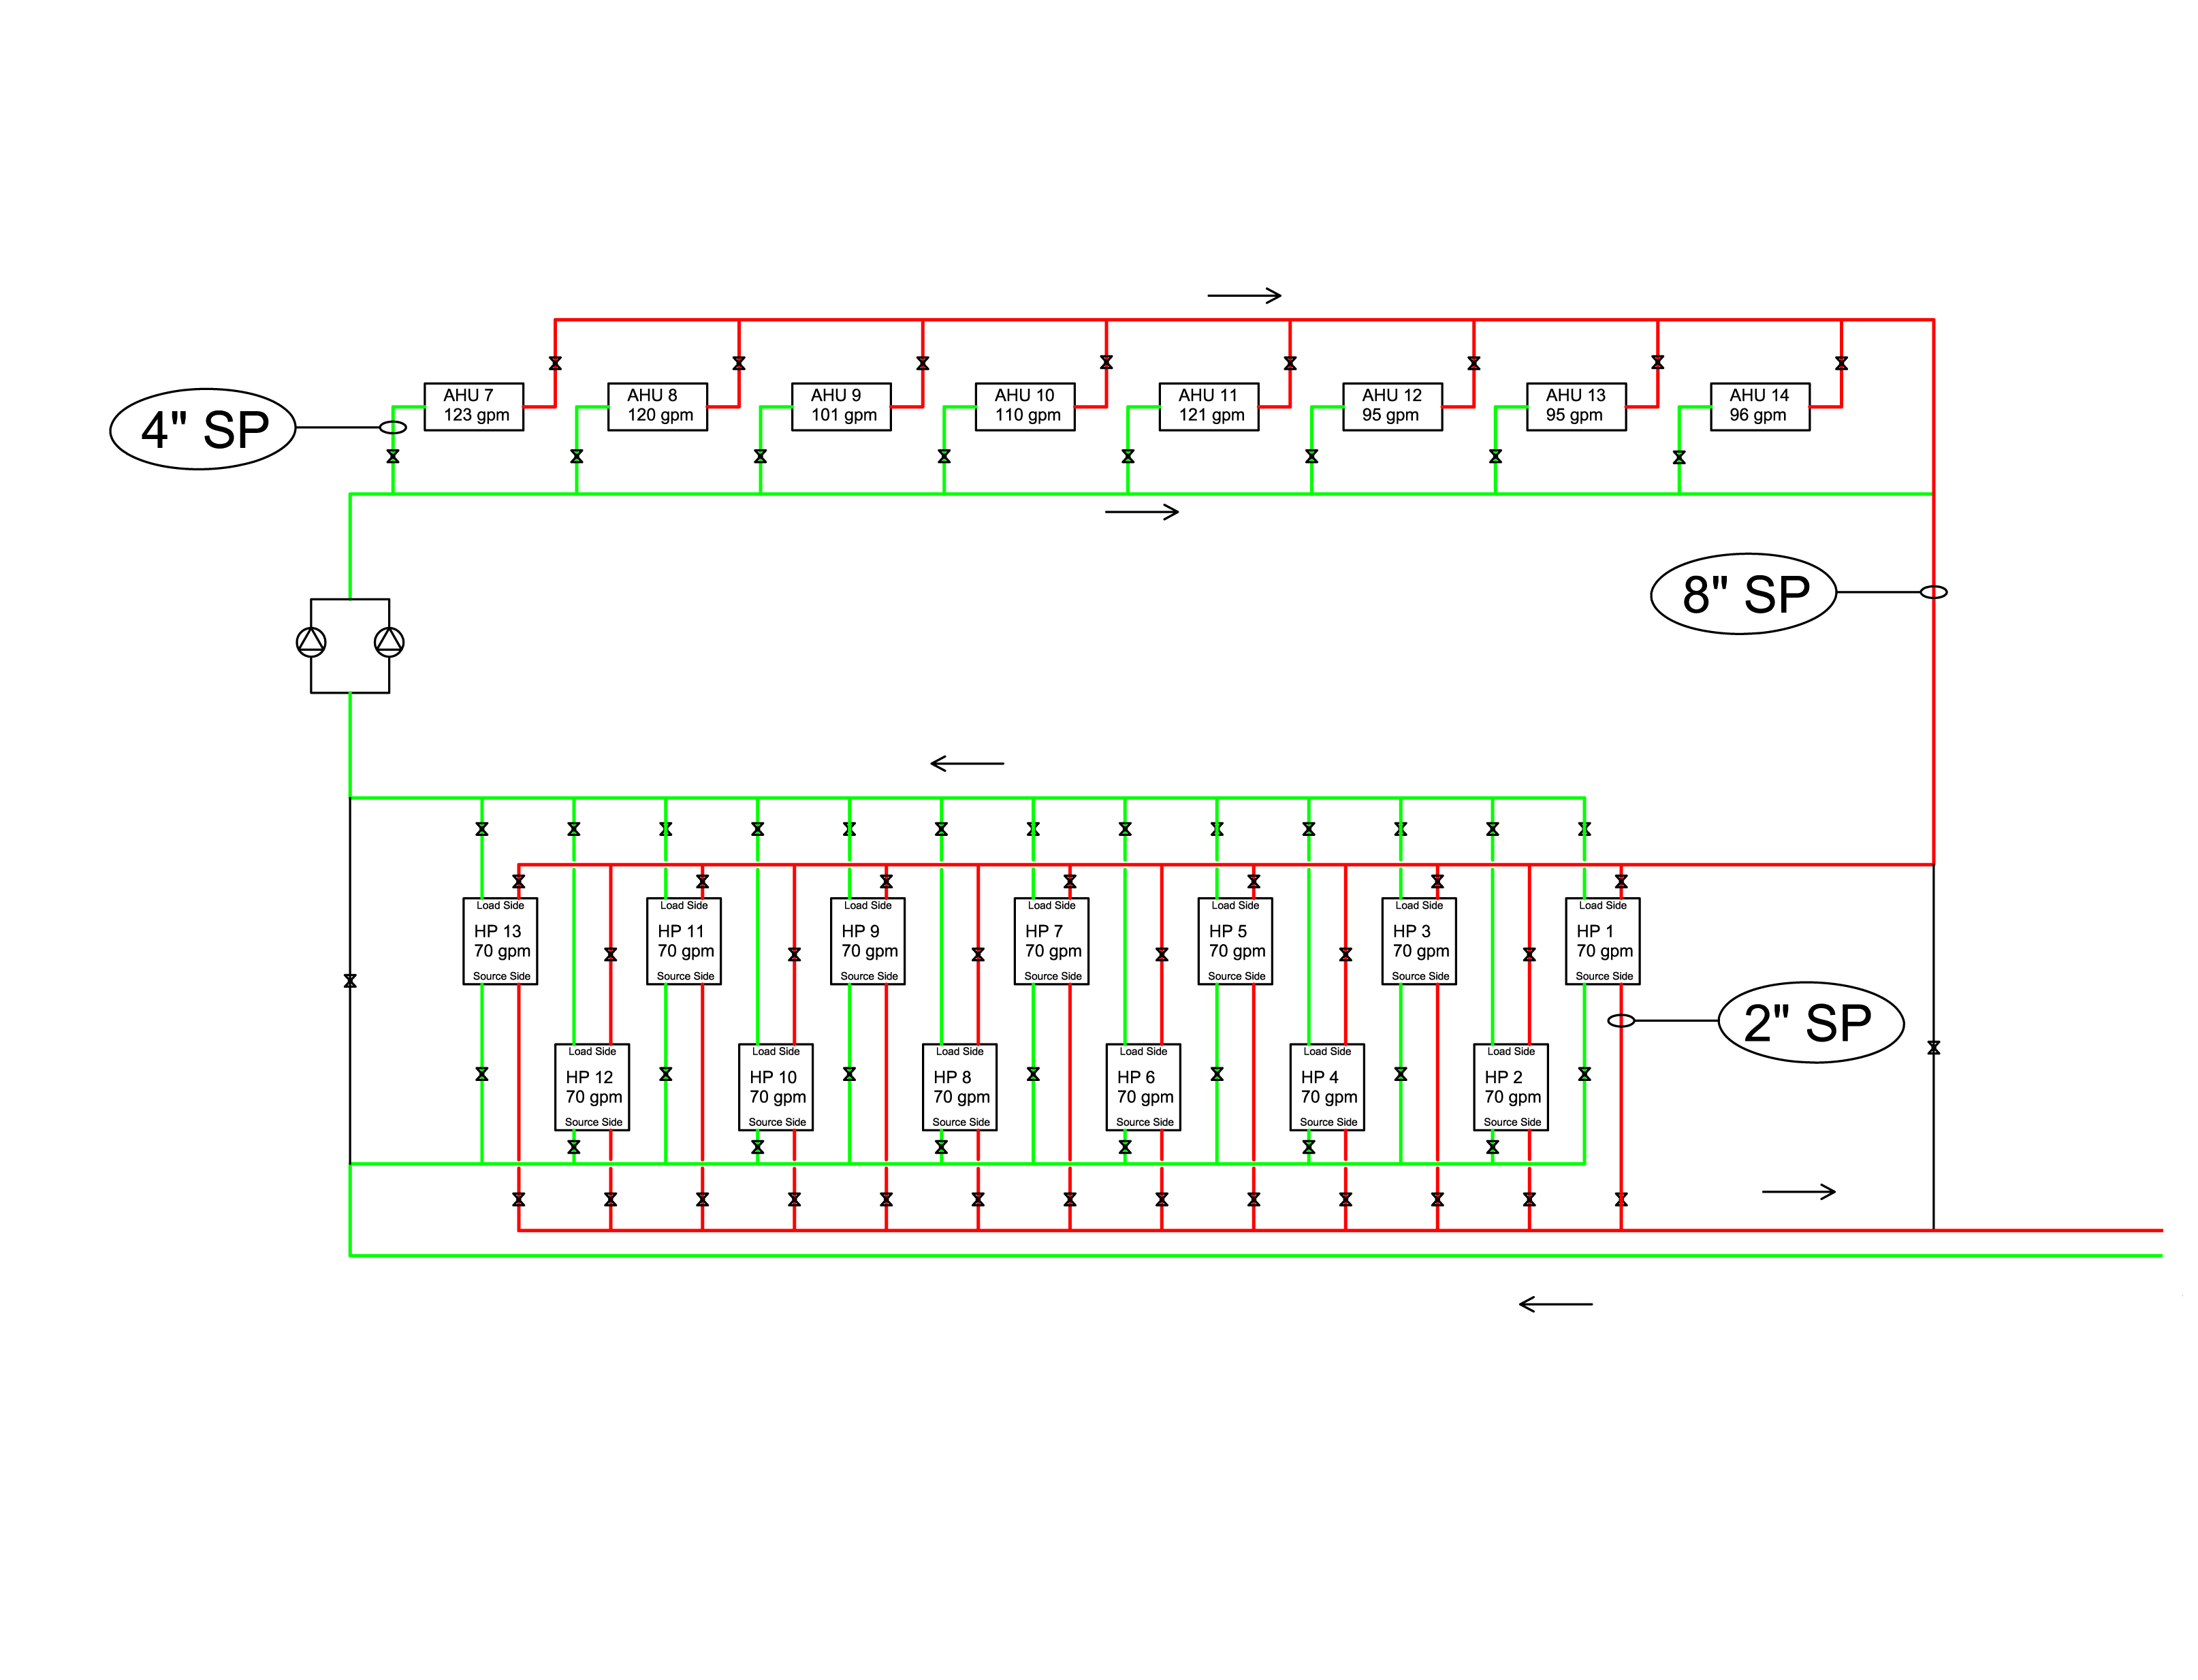
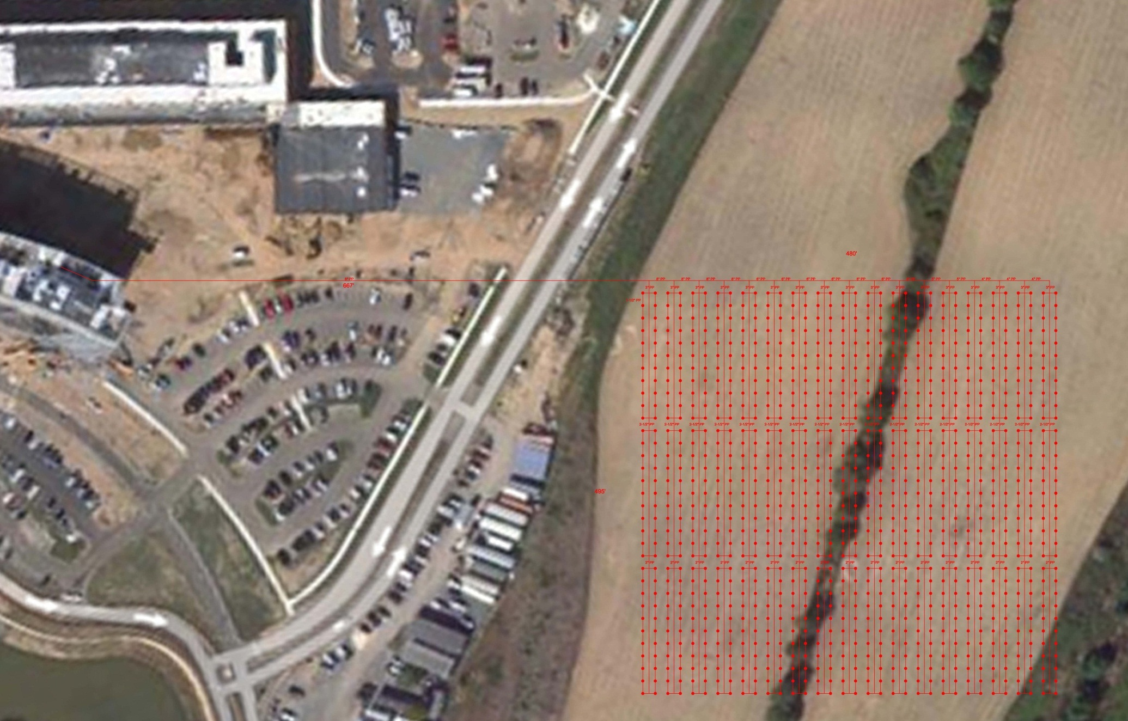
Source Side Pump
Introduction
University Medical Center of Princeton Overview
  Building
  Current systems
Goals
Depth
  Replace HRUs with GSHP/GHX
  Economic Analysis
  Implement Micro Steam Turbines
Electrical Breadth
Acoustical Breadth
Summary and Highlights
Appendices
Load Side Pump

Slide 8
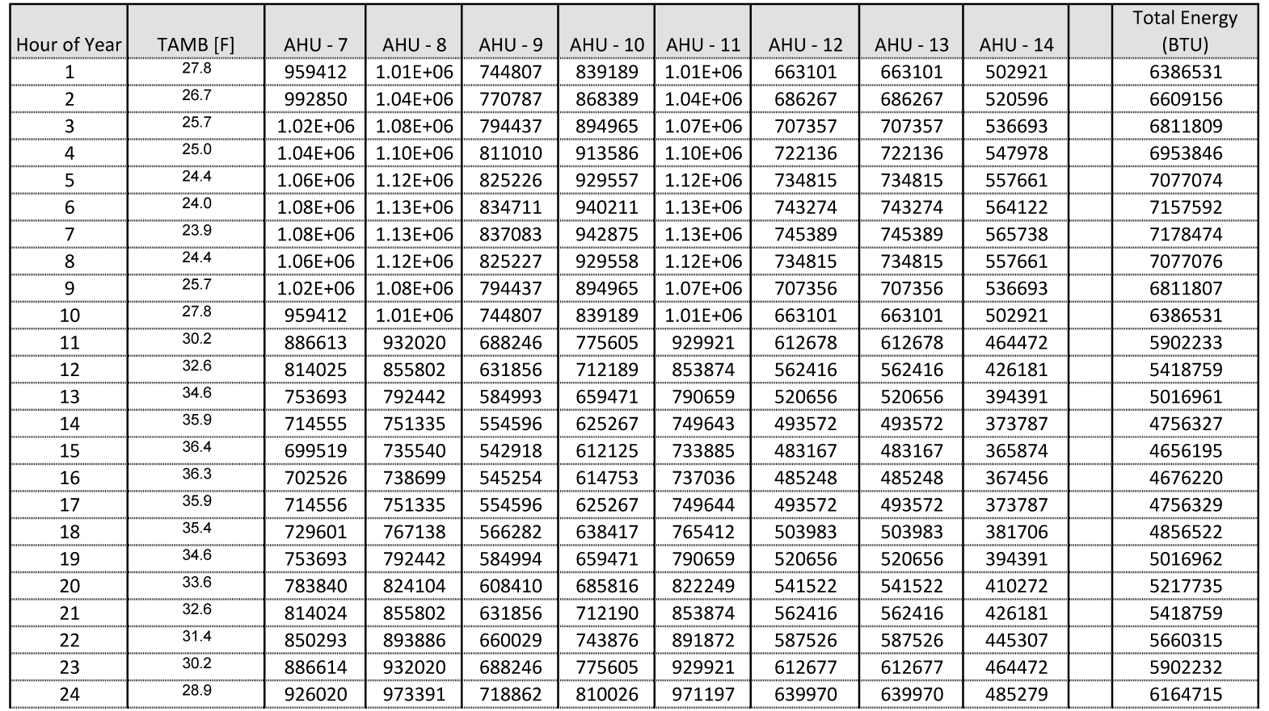
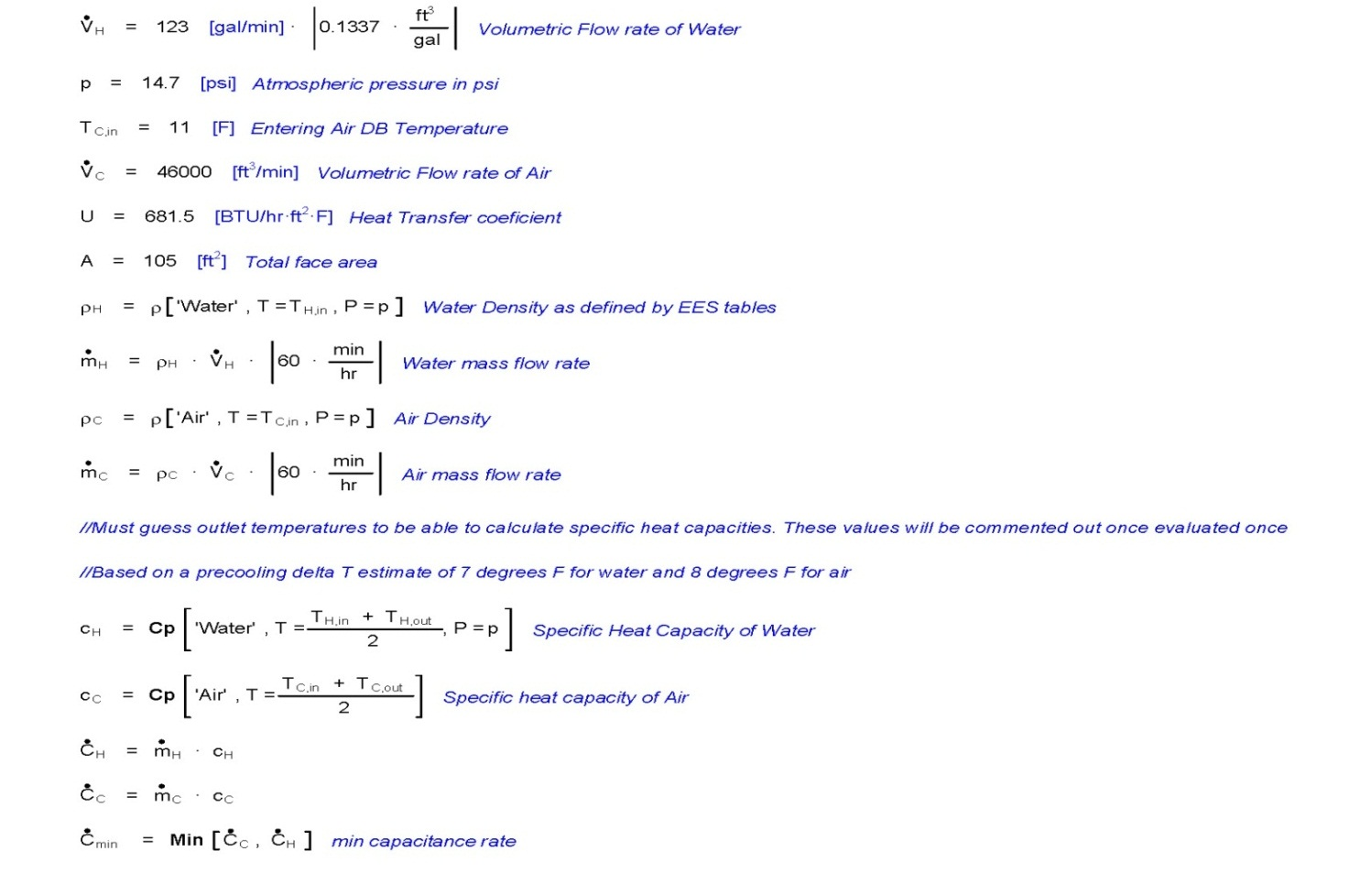
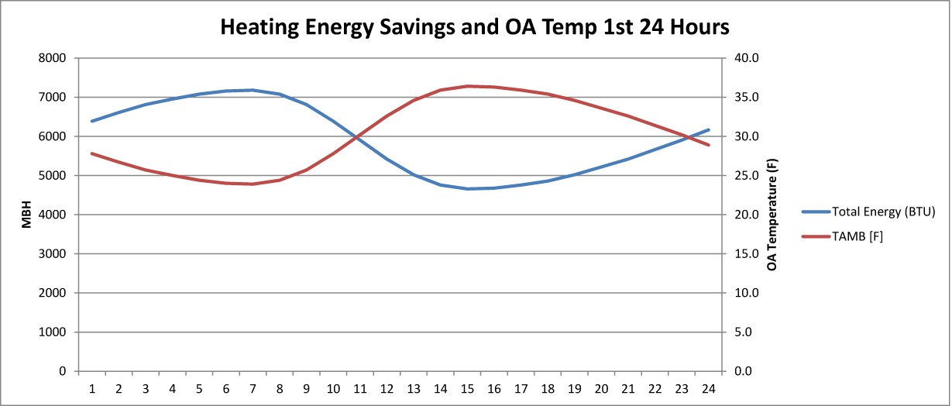
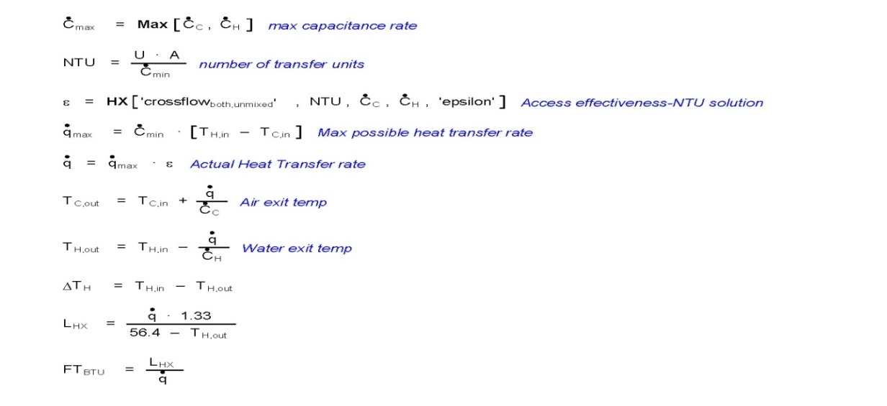
Simple Payback for Heat Pump System to Base System
Energy Savings of GSHP and GHX and hours of Operation
Peak Heating Capacity Peak (MBTU) | Annual Heating Savings (MBH) | Operating Hours |  | Peak Cooling Capacity (Tons) | Annual Cooling Savings (Tons) | Operating Hours
7,178.50 | 18,693,690 | 5,243 |  | 219 | 101,830 | 983
EES to calculate hourly energy savings
Alternative Heating Savings |  |  |  | Alternative Cooling Savings
Annual Heating Savings (MBH) | Natural Gas Savings (Therms) | NG Savings |  | Annual Cooling Savings (Tons) | Natural Gas Savings (Therms) | NG Savings
18,693,690 | 333,816 | $65,428 |  | 1,221,956 | 101,830 | $19,959
Simple Payback for GSHP and GHX Alternative
Total NG Savings | Operating Cost | Total Cost Savings |  | Additional Capital Investment |  | Simple Payback (years)
$85,387 | $29,939 | $55,448 |  | $6,359,695 |  | 115
Compared to 23 for
Glycol Runaround

Slide 9
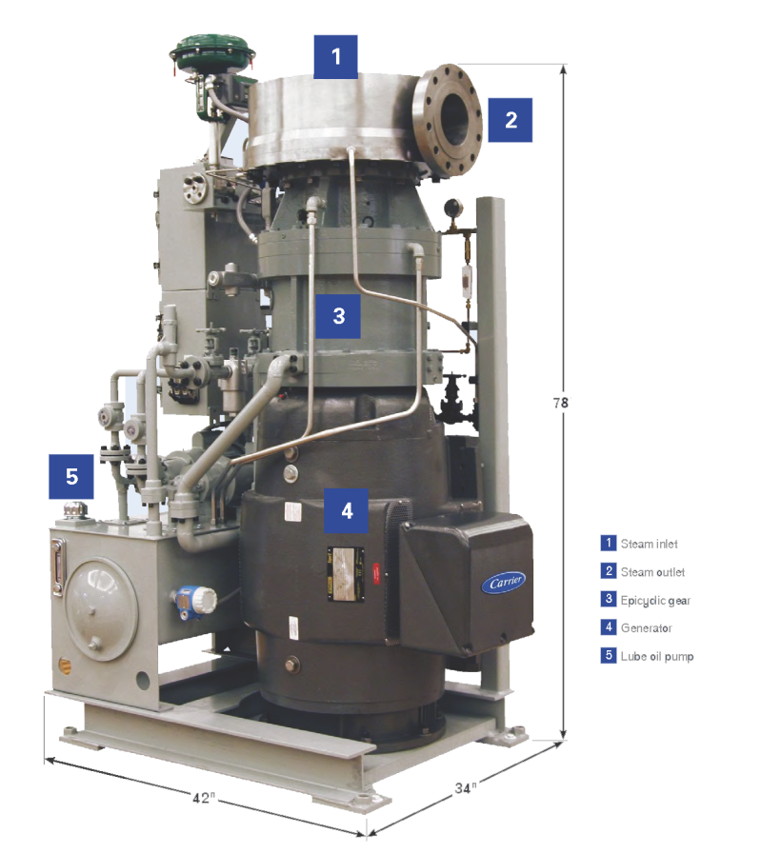
Micro Steam Turbine
Microsteam Turbine Design Criteria
Inlet Pressure (psi) | Outlet Pressure (psi) | Steam Flow Rate (lb/hr) | Steam Temperature (ºF)
150 | 15 | 41,400 | 365.87
Location of PRV
Flow Rate
Energy Output
Introduction
University Medical Center of Princeton Overview
  Building
  Current systems
Goals
Depth
  Replace HRUs with GSHP/GHX
  Economic Analysis
  Implement Micro Steam Turbines
Electrical Breadth
Acoustical Breadth
Summary and Highlights
Appendices
Microsteam Turbine Performanc Data
Inlet Pressure (psi) | Outlet Pressure (psi) | Steam Flow Rate (lb/hr) | Steam Temperature (ºF) | Electrical Output (kW)
150 | 15 | 11,150 | 366 | 275
What to power?
Paralleling Switchgear
Transfer Switch
AHU Electrical Load Requirements
Unit | HP | kVA | FLA | Volt | Phase | kW
AHU 1 | 12x10 = 120 | 130 | 156 | 480 | 3 | 191
AHU 2 | 9x7.5 = 67.5 | 80 | 96 | 480 | 3 | 118
AHU 3 | 12x7.5 = 90 | 103 | 124 | 480 | 3 | 152
Annual Peak Savings
461 kW
Carrier.com

Slide 10
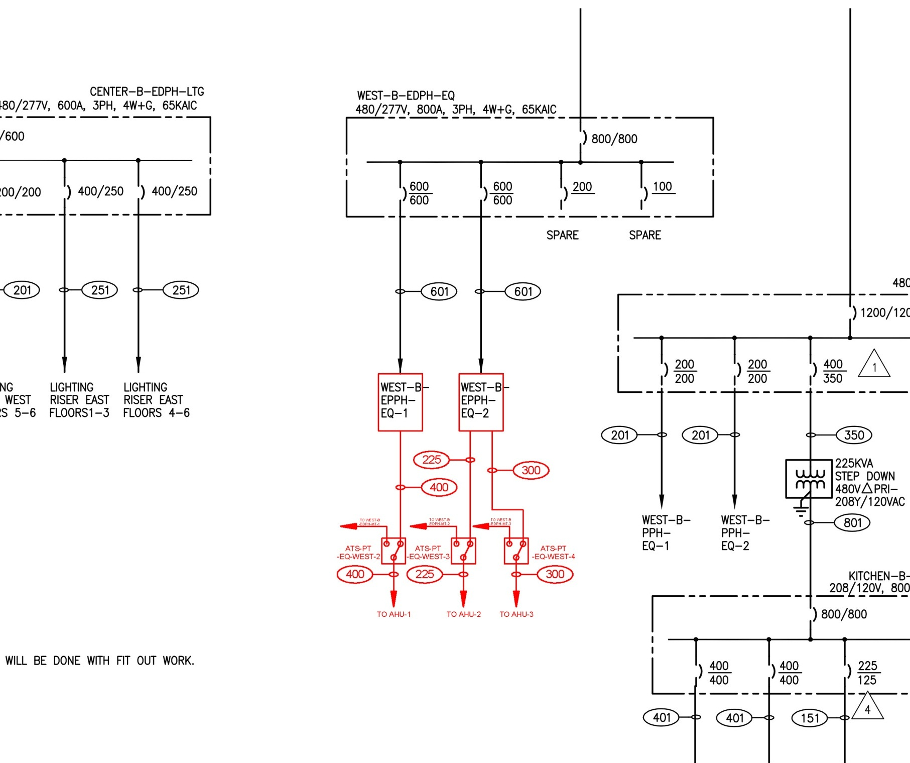
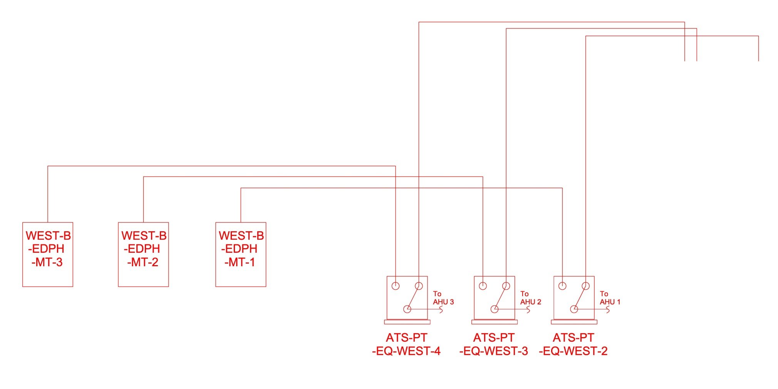
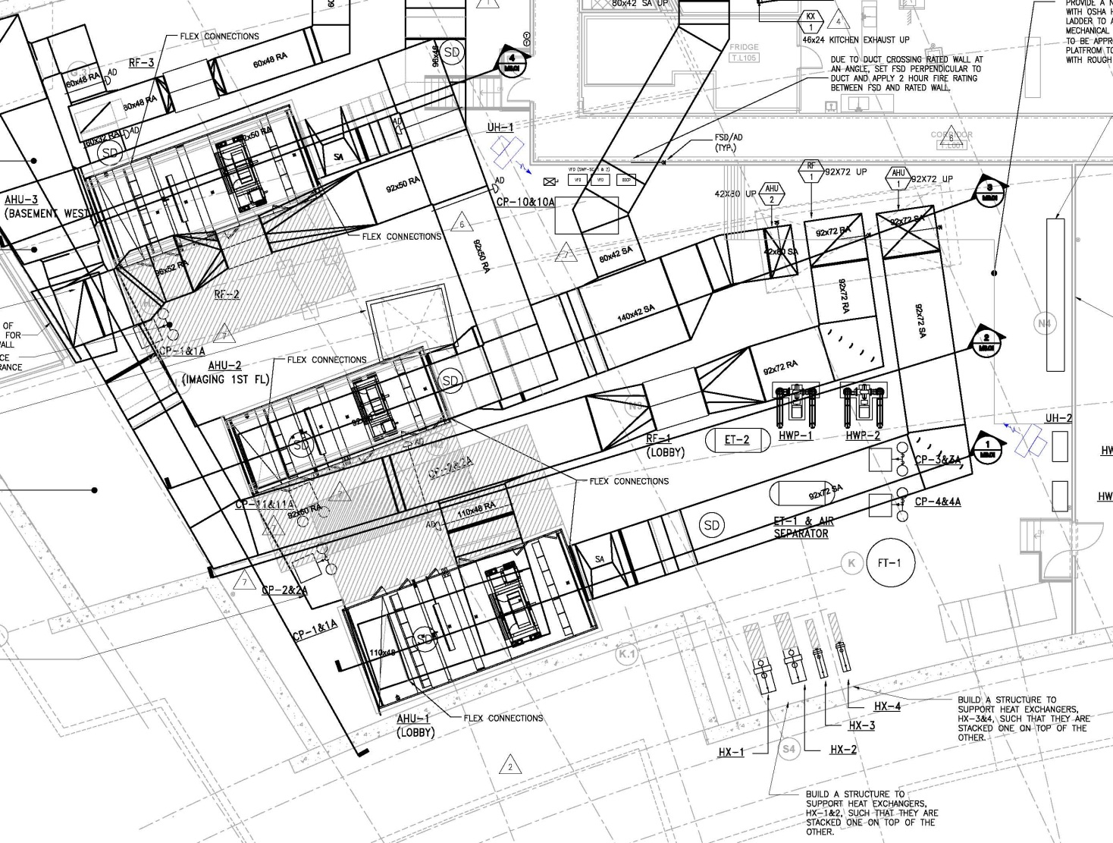
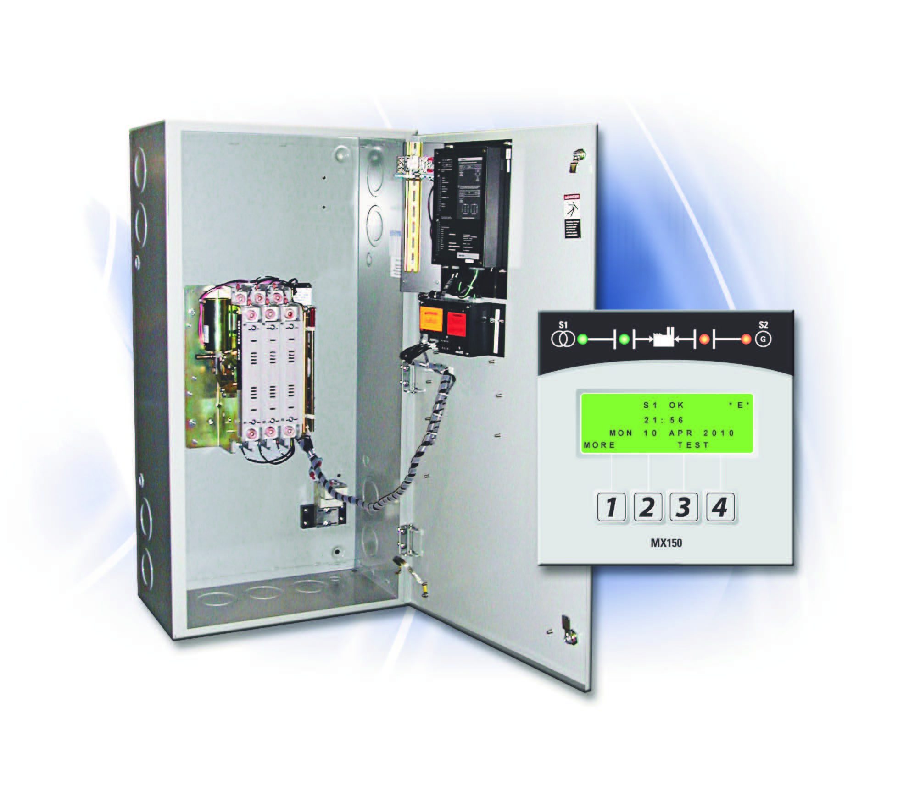
Riser Diagram with Turbines and Transfer Switches
Single Line with Turbines Transfer Switches
Existing Panel Boards
Lower Level Mechanical Room Layout
Pressure Reducing Valve
Station 1
AHU 3
AHU 2
AHU 1

Slide 11
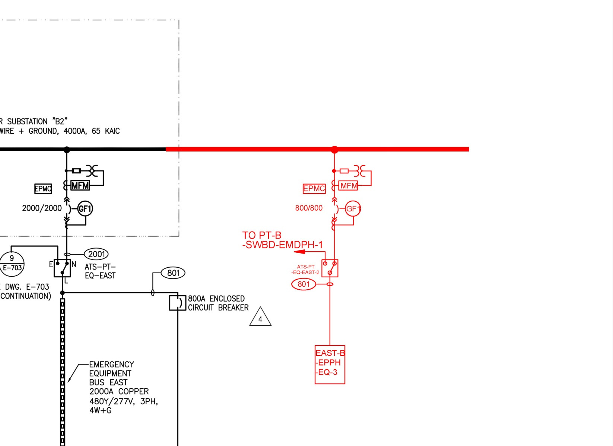
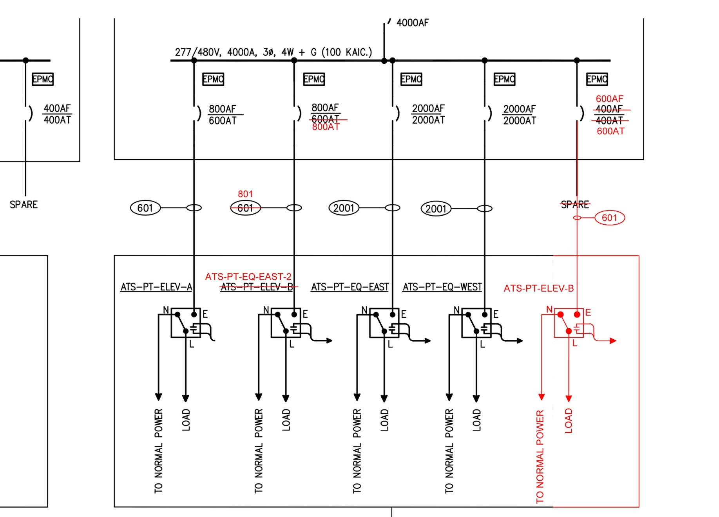
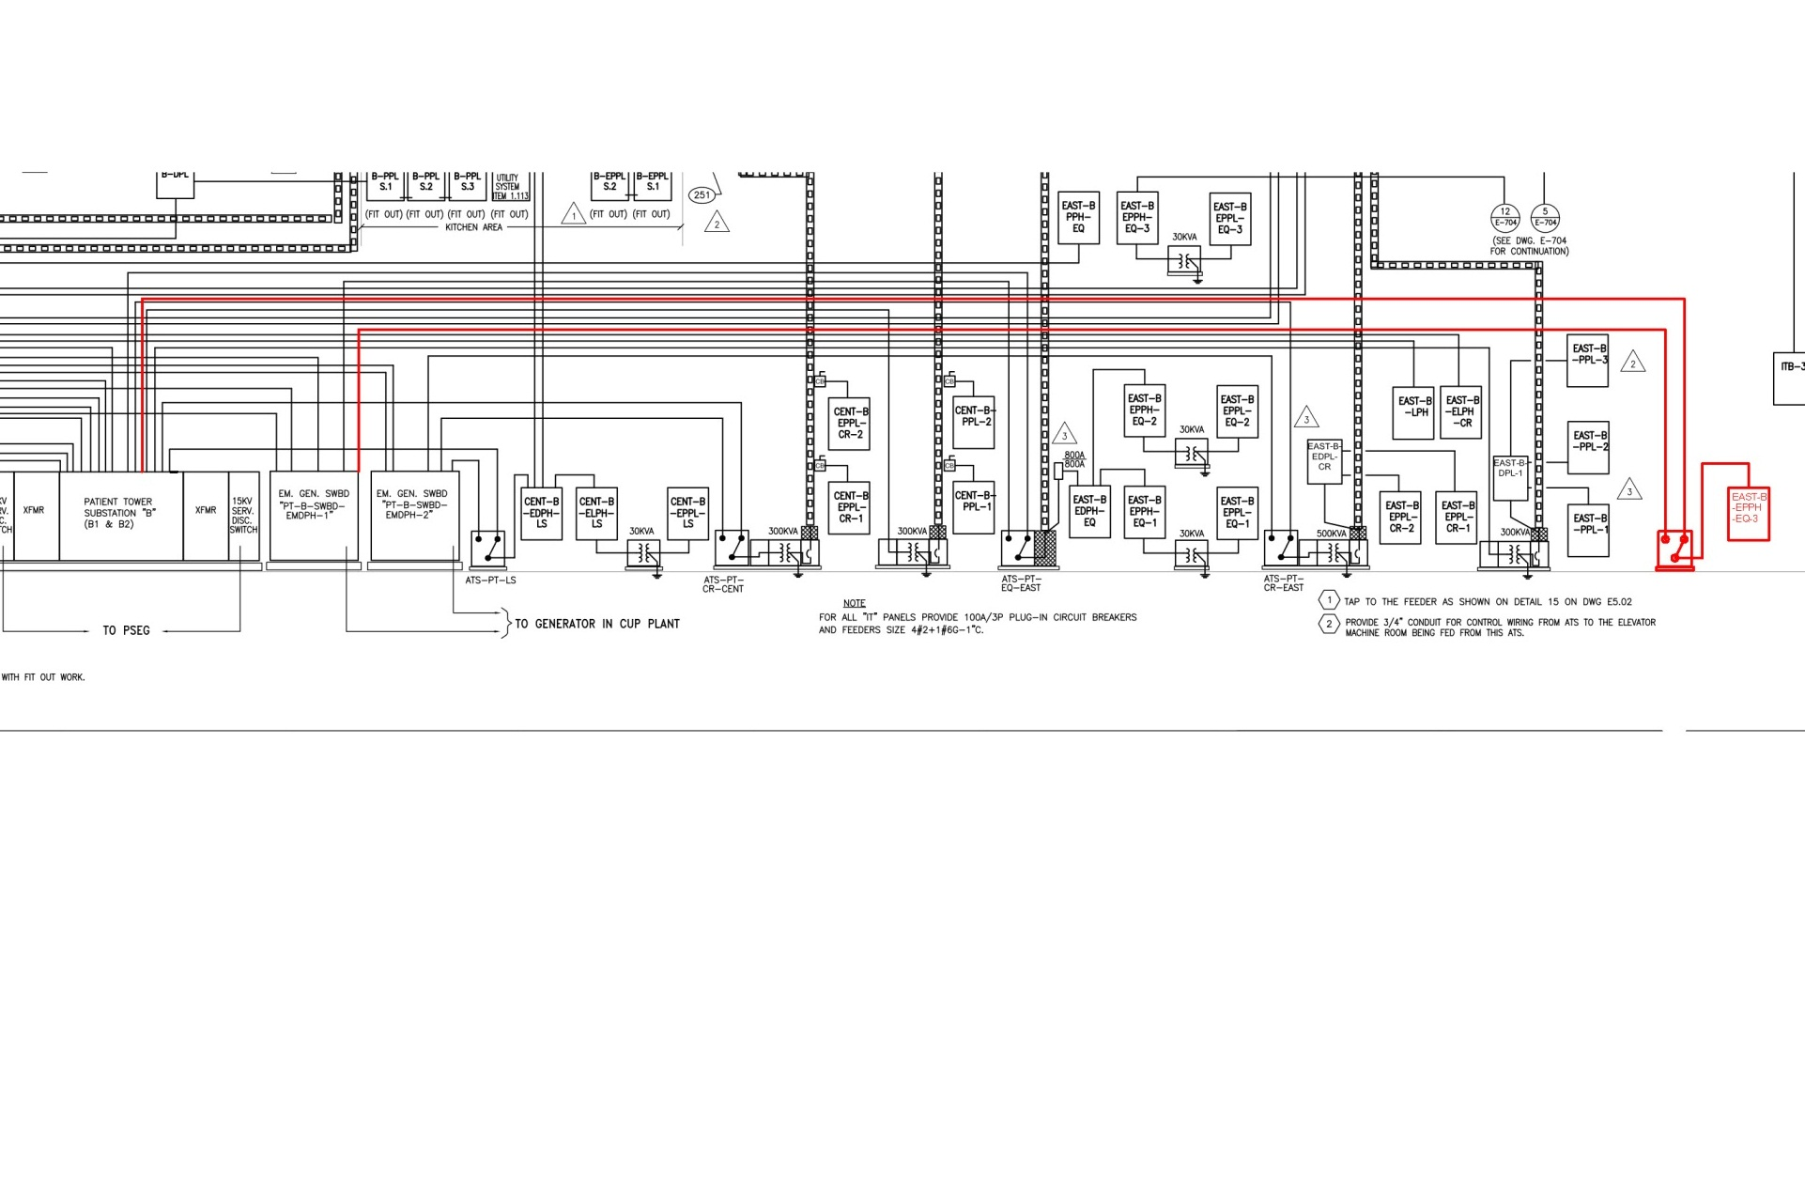
Single Line with HP Transfer Switch and Panel Board
Emergency Single Line with HP Transfer Switch
Introduction
University Medical Center of Princeton Overview
  Building
  Current systems
Goals
Depth
  Replace HRUs with GSHP/GHX
  Economic Analysis
  Implement Micro Steam Turbines
Electrical Breadth
Acoustical Breadth
Summary and Highlights
Appendices
Riser Drawing with HP Transfer Switch and Panel Board

Slide 12
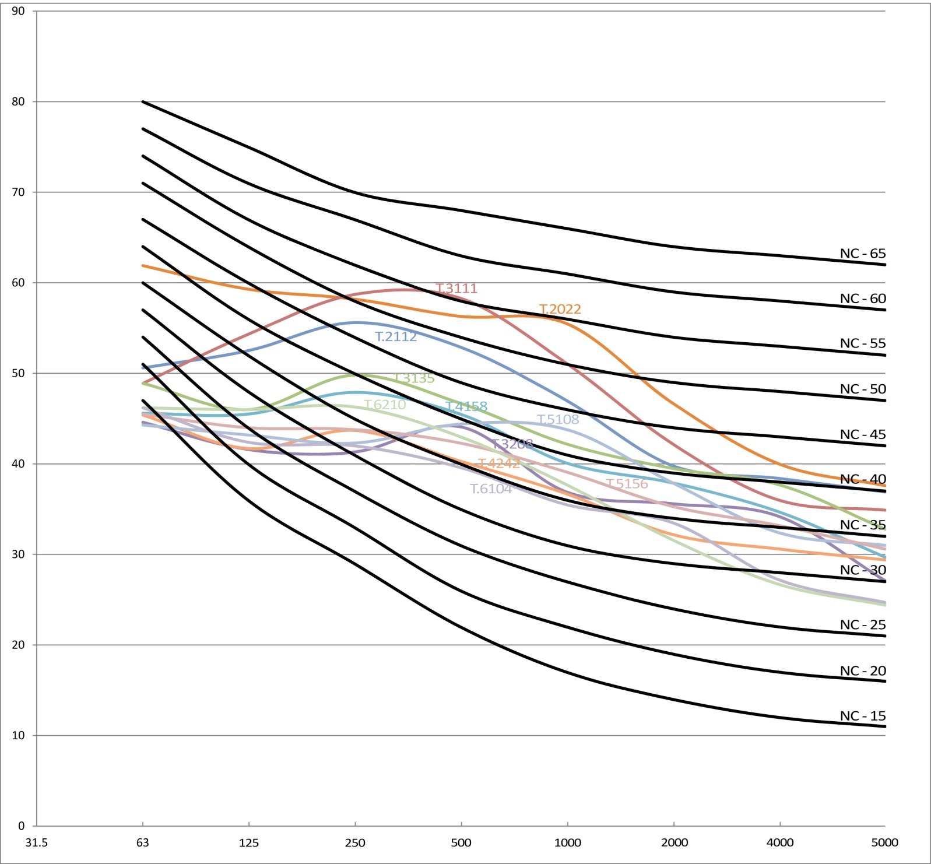
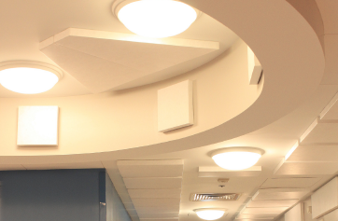

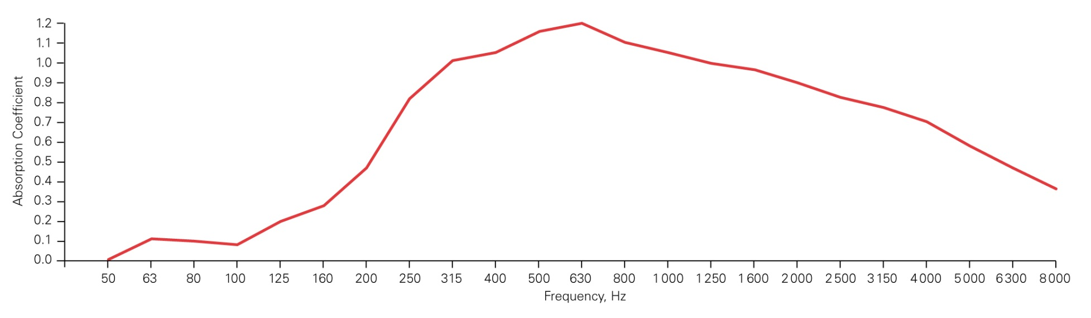
Acoustical Breadth
Acoustical Comfort Improves Healing Process
AIA / AHA dBA and NC standards
DuPont Audio Comfort Panels with Tyvek Cover
Introduction
University Medical Center of Princeton Overview
  Building
  Current systems
Goals
Depth
  Replace HRUs with GSHP/GHX
  Economic Analysis
  Implement Micro Steam Turbines
Electrical Breadth
Acoustical Breadth
Summary and Highlights
Appendices
AudioComfort Panel Area Summary
File Name | Room Type | Compliant based on dBA | NC | Compliant based in NC | DuPont Panel Area Required to meet NC compliance | Area of Dupont panel to meet dBA
1-001 T.2022.wav | Staff Work | NO | 55 | NO | 245 | 400
2-001 T.2112.wav | Hold Recovery Room | NO | 48 | NO | 310 | 310
2-002 T.3111.wav | Family Respite | NO | 56 | NO | 483 | 250
2-003 T.3135.wav | Critical Patient Room | NO | 43 | Yes | -- | 100
2-004 T.3208.wav | Intermediate Patient Room | Yes | 39 | Yes | -- | --
2-005 T.4158.wav | Patient Room | Yes | 41 | Yes | -- | --
2-006 T.4212.wav | Patient Room | Yes | 36 | Yes | -- | --
2-007 T.5108.wav | Patient Room | Yes | 43 | Yes | -- | --
2-008 T.5156.wav | Patient Room | Yes | 38 | Yes | -- | --
2-009 T.6210.wav | Nursery Patient Room | Yes | 38 | Yes | -- | --
2-010 T.6104.wav | Patient Room | Yes | 35 | Yes | -- | --

Slide 13

Summary and Highlights
Simple Payback of Runaround Glycol Heat Recovery System
Heating Base Cost | Heating Cost with HR | Savings |  | Cooling Base Cost | Cooling Cost with HR | Savings |  | Total Cost Savings |  | Additional Capital Investment |  | Simple Payback (years)
$134,946 | $91,512 | $43,434 |  | $476,779 | $466,914 | $9,865 |  | $53,299 |  | $1,233,000 |  | 23
Evaluated HR System
  23 Year Payback
Designed GSHP / GHX
  115 Year Payback
Final Remarks
Introduction
University Medical Center of Princeton Overview
  Building
  Current systems
Goals
Depth
  Replace HRUs with GSHP/GHX
  Economic Analysis
  Implement Micro Steam Turbines
Electrical Breadth
Acoustical Breadth
Summary and Highlights
Appendices
Simple Payback for GSHP and GHX Alternative
Total NG Savings | Operating Cost | Total Cost Savings |  | Additional Capital Investment |  | Simple Payback (years)
$85,387 | $29,939 | $55,448 |  | $6,359,695 |  | 115
Implemented Microsteam Turbines
  Peak savings 461 kW
Evaluated Room Acoustics
  DuPont AudioComfort Panels

Slide 14
Acknowledgements
References
I would like to take this opportunity to thank all those who played a vital role in this project.
Turner Construction, for granting access to the drawings and information on this wonderful building.
Chris Auer and the rest of the field office at UMCP for taking the time out of their day to help me with my requests
Pam Garbini, for sharing her knowledge and wisdom about UMCP and the AE senior thesi.
Princeton Heathcare Systems for granting me permission to use their building and construction photos.
Syska Hannessy, for sharing their assumptions and methods for generating an energy model.
Dr. Stephen Treado my thesis advisor.
The rest of the AE faculty and staff and students.
ASHRAE (2007). Handbook – Fundamentals. American Society of Heating, Refrigerating and Air-Conditioning Engineers, Inc.
ASHRAE (2007). Handbook – Applications. American Society of Heating, Refrigerating and Air-Conditioning Engineers, Inc.
Author. RSMeans mechanical cost data 2012. Norwell, MA: RSMeans, 2011.
Author. RSMeans Plumbing cost data, 2011. Kingston, MA: R.S. Means Co, 2010.
Davenny, Benjamin. Green Guide for Health Care Technical Brief: Acoustic Environment. 2007
Dept, Rsm. Heavy Construction Cost Data. City: R S Means Co, 2011.
HOK/RMJM Hillier – A Joint Venture. Architectural Construction Documents. HOK/RMJM Hillier. New York, NY and Princeton, NJ.
McQuay. Geothermal Heat Pump Design Manual. McQuay Air Conditioning. 2002.
National Fire Protection Association. NEC 2008. National Fire Protection Association. Massachusetts. 2008
Princeton Healthcare Systems. 2011. “New Hospital Project”. Website. November 2011. Princeton, NJ. < http://www.princetonhcs.org/default.aspx?p=8485>.
Statesupply.com
Syska Hennessy. 2009. MEP Construction Documents. Syska Hennessy. New York, NY. 2009.
Turner Construction. 2009. Turner Construction Corp. Mechanical Bid. Turner Construction Corp. New York, NY. 2009.
Qualityswitchgear.com
Introduction
University Medical Center of Princeton Overview
  Building
  Current systems
Goals
Depth
  Replace HRUs with GSHP/GHX
  Economic Analysis
  Implement Micro Steam Turbines
Electrical Breadth
Acoustical Breadth
Summary and Highlights
Appendices

Slide 15
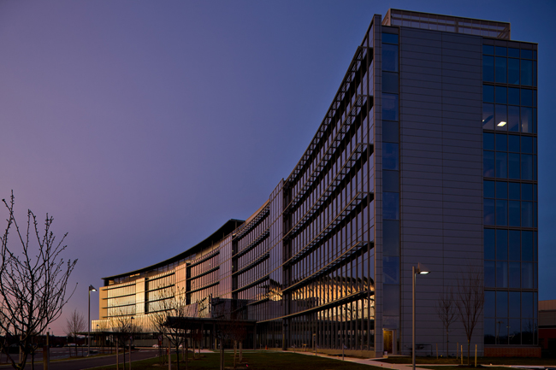
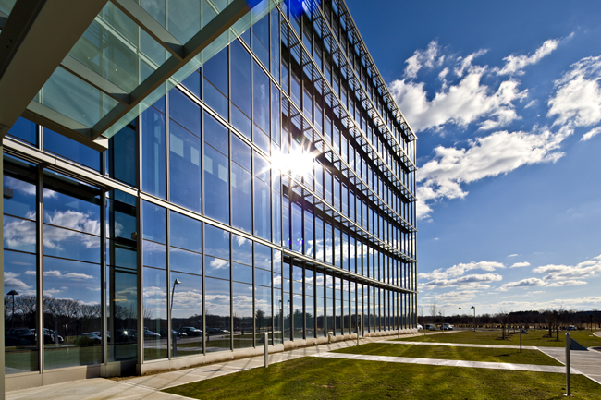
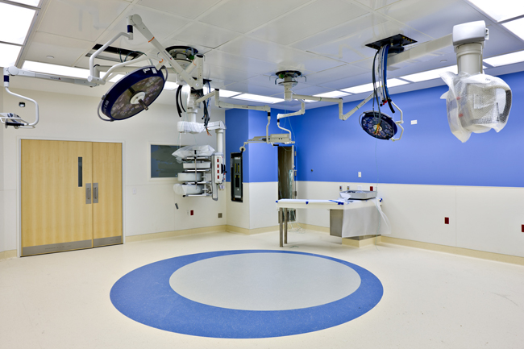

Thank You

Slide 16
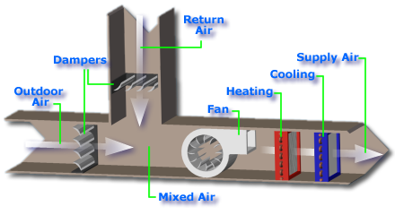
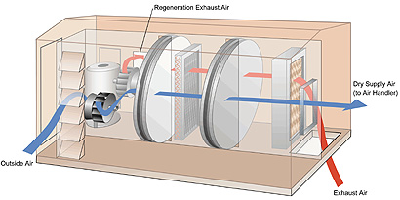
Economizer
Energy Recovery Wheel
Introduction
University Medical Center of Princeton Overview
  Building
  Current systems
Goals
Depth
  Replace HRUs with GSHP/GHX
  Economic Analysis
  Implement Micro Steam Turbines
Electrical Breadth
Acoustical Breadth
Summary and Highlights
Appendices
Advantages
Reduction in outdoor air
Reduction in Energy Consumption
Disadvantages
Cross Contamination
More Control Logic and Sensors
Advantages
Reduction in Energy Consumption
Enthalpy Recovered
Disadvantages
Cross Contamination
Large Duct Work on Roof

Slide 17
Hybrid Systems
Introduction
University Medical Center of Princeton Overview
  Building
  Current systems
Goals
Depth
  Replace HRUs with GSHP/GHX
  Economic Analysis
  Implement Micro Steam Turbines
Electrical Breadth
Acoustical Breadth
Summary and Highlights
Appendices
Fewer Heat Pumps in series provide large delta T mix into rest of flow
Decrease water flow on load side by percent of current
Preheat water going into heat pump in winter to decrease delta T

